Slide 1
Chapter 10
Data Link Control
Line Discipline
Flow Control
Error Control
WCB/McGraw-Hill
© The McGraw-Hill Companies, Inc., 1998

Slide 2
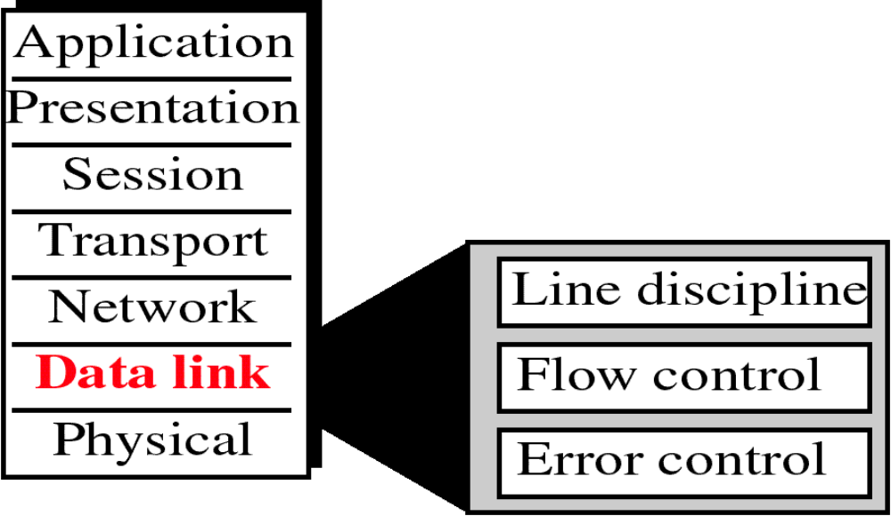
Figure 10-1
Data Link Layer
WCB/McGraw-Hill
© The McGraw-Hill Companies, Inc., 1998

Slide 3
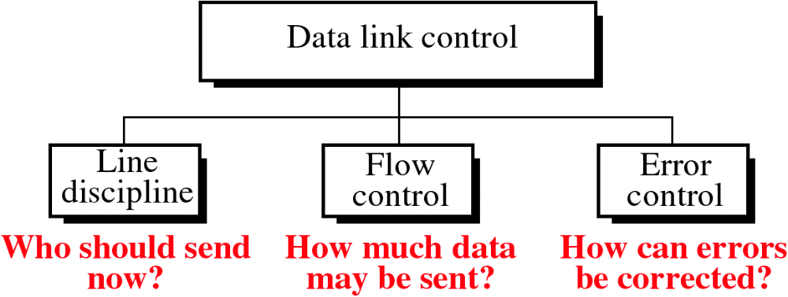
Figure 10-2
WCB/McGraw-Hill
© The McGraw-Hill Companies, Inc., 1998

Slide 4
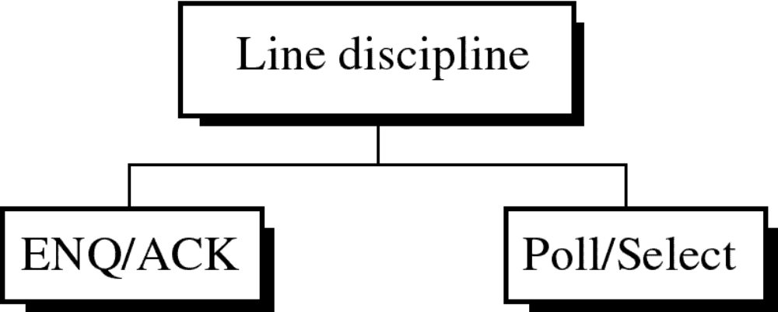
Figure 10-3
WCB/McGraw-Hill
© The McGraw-Hill Companies, Inc., 1998

Slide 5
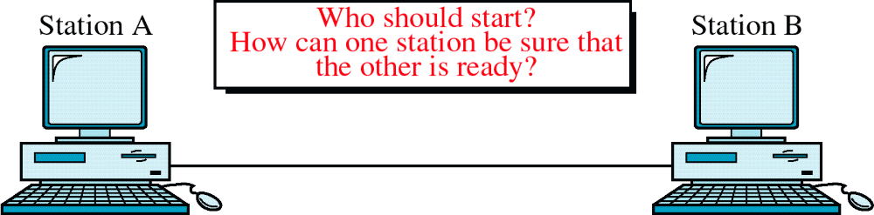
Figure 10-4
ENQ/ACK
WCB/McGraw-Hill
© The McGraw-Hill Companies, Inc., 1998

Slide 6
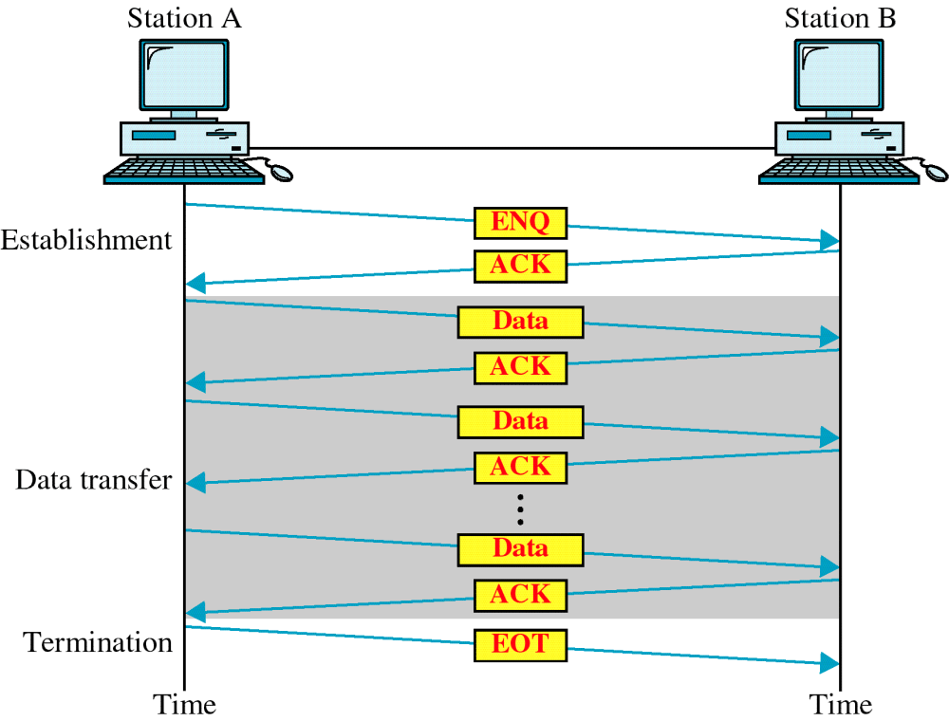
Figure 10-5
ENQ/ACK
WCB/McGraw-Hill
© The McGraw-Hill Companies, Inc., 1998

Slide 7
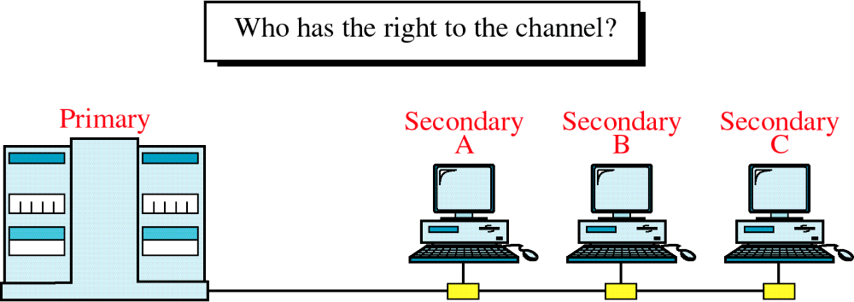
Figure 10-6
Multipoint Discipline
WCB/McGraw-Hill
© The McGraw-Hill Companies, Inc., 1998

Slide 8
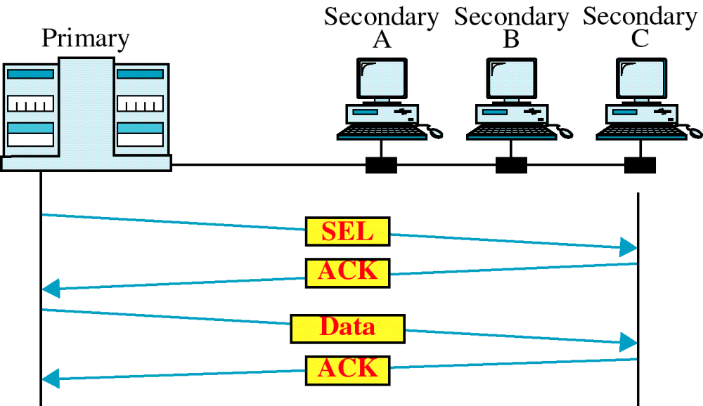
Figure 10-7
Select
WCB/McGraw-Hill
© The McGraw-Hill Companies, Inc., 1998

Slide 9
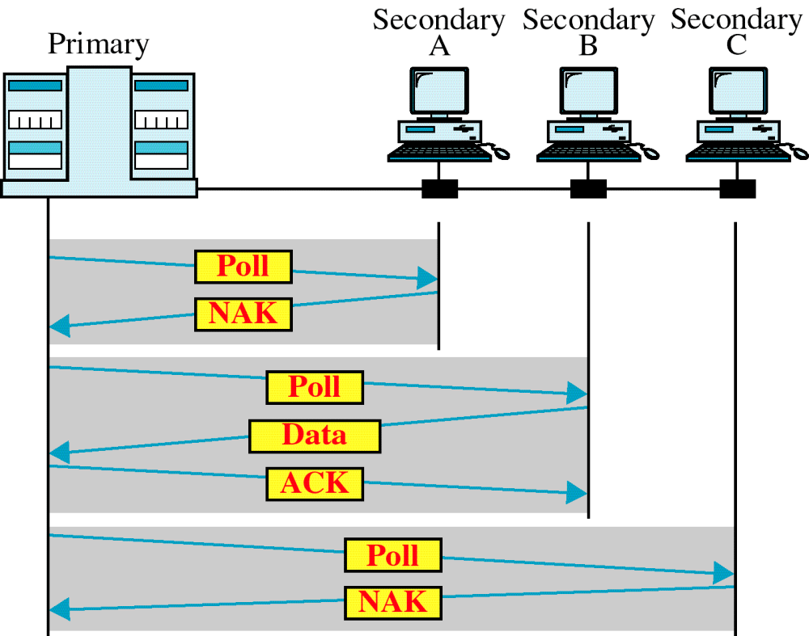
Figure 10-8
Poll
WCB/McGraw-Hill
© The McGraw-Hill Companies, Inc., 1998

